Slide 1
Java Collections

Slide 2
Key Topics
Data Structures Introduction
The Java Collection Framework
Working With Collections
Maps

Slide 3
Data Structures Introduction

Slide 4
What is a Data Structure?
A data structure is a format for storing and managing more than one piece of data
Arrays are data structures
Elements can be removed, added, searched for, etc
Each data structure has its own way of storing and working with the data it holds
There are two fundamental ways of storing information in data structures:
In arrays
With nodes

Slide 5
Java Collection Framework

Slide 6
The Collection Interface
The Java Collection Framework provides built-in data structures for the user to work with
It contains interfaces that define what behavior the data structures should have
It also contains concrete classes that represent each data structure
The main branch of the Collection Framework is the collection hierarchy. Its root is the Collection interface and it defines a set of behaviors common to all collections in Java (except Maps, which are in another branch entirely)
https://docs.oracle.com/javase/8/docs/api/java/util/Collection.html
Collections can be broken down into three types: Lists, Sets, and Queues

Slide 7
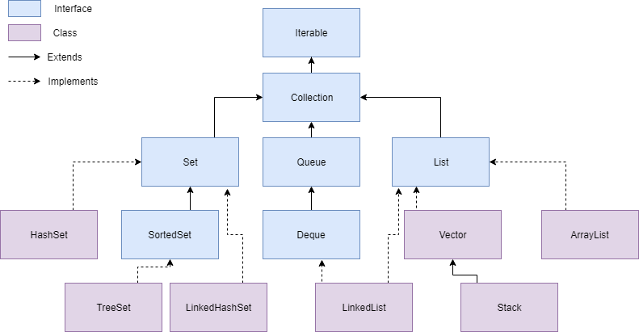
Collection Hierarchy

Slide 8
Important Interfaces in the Collection Framework
Iterable – Requires that every collection can be iterated over (each element can be accessed, one by one)
Collection – An Interface in Java that defines an architecture for storing and manipulating objects
Set – A collection which cannot contain duplicate elements
Queue – An ordered collection of objects which utilizes a first-in-first-out principle
List – An ordered collection of objects which utilizes indexes

Slide 9
Working With Collections

Slide 10
Wrapper Classes
Allow you to treat primitives like objects
Each object created from the following classes wraps a single primitive value of the corresponding type:
Byte
Short
Integer
Float
Long
Double
Boolean
Character
Why do we need Wrappers? Collections can only hold objects, not primitives.

Slide 11
Generics Introduction
Generics: defining placeholder types to allow classes or methods to be more flexible with the type of objects they can work with
How generics work with collections:
Java Collection classes define generic placeholder types
When objects of these classes are created, you can specify what type of object the collection can hold
Below is an example of creating a collection:
ArrayList<String> list = new ArrayList<String> ();

Slide 12
Working with Collections
Creating:
Adding:
Removing:
Iterating:
ArrayList<String> list = new ArrayList<> ();
list.add(“Hello”);
list.remove(“Hello”);
for (String element : list) {
// do something
}

Slide 13
Maps

Slide 14
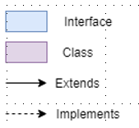
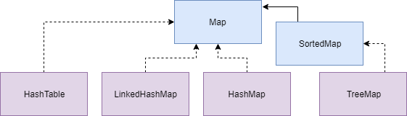
Map Hierarchy
Although maps are a branch of the Collection Framework, they are not collections
Collections are groups of objects
Maps are groups of key-value pairs

Slide 15
Creating Java Maps
Creating:
Adding/Removing:
Iterating over every entry:
Map<String, Integer> map = new HashMap<> ();
map.put(“cat”, 2);
map.remove(“cat”);
Set<Entry<String, Integer>> entries = map.entrySet();
for (Map.Entry<String, Integer> entry: entries) {
// do something
}

Slide 16
Map vs Collection Methods
 | Collection | Map
Add an element | add(object) | put(key, value)
Remove an element | remove(object) | remove(key)
Iterate over data structure | For-each loop | get something iterable using either keySet(), values(), or entrySet() then use for-each loop

Slide 17
Recall
What is a data structure?
What is the Java Collection Framework?
What is a Set, Queue, List, and Map?
What are some methods I can use with collections? With Maps?

